Slide 1

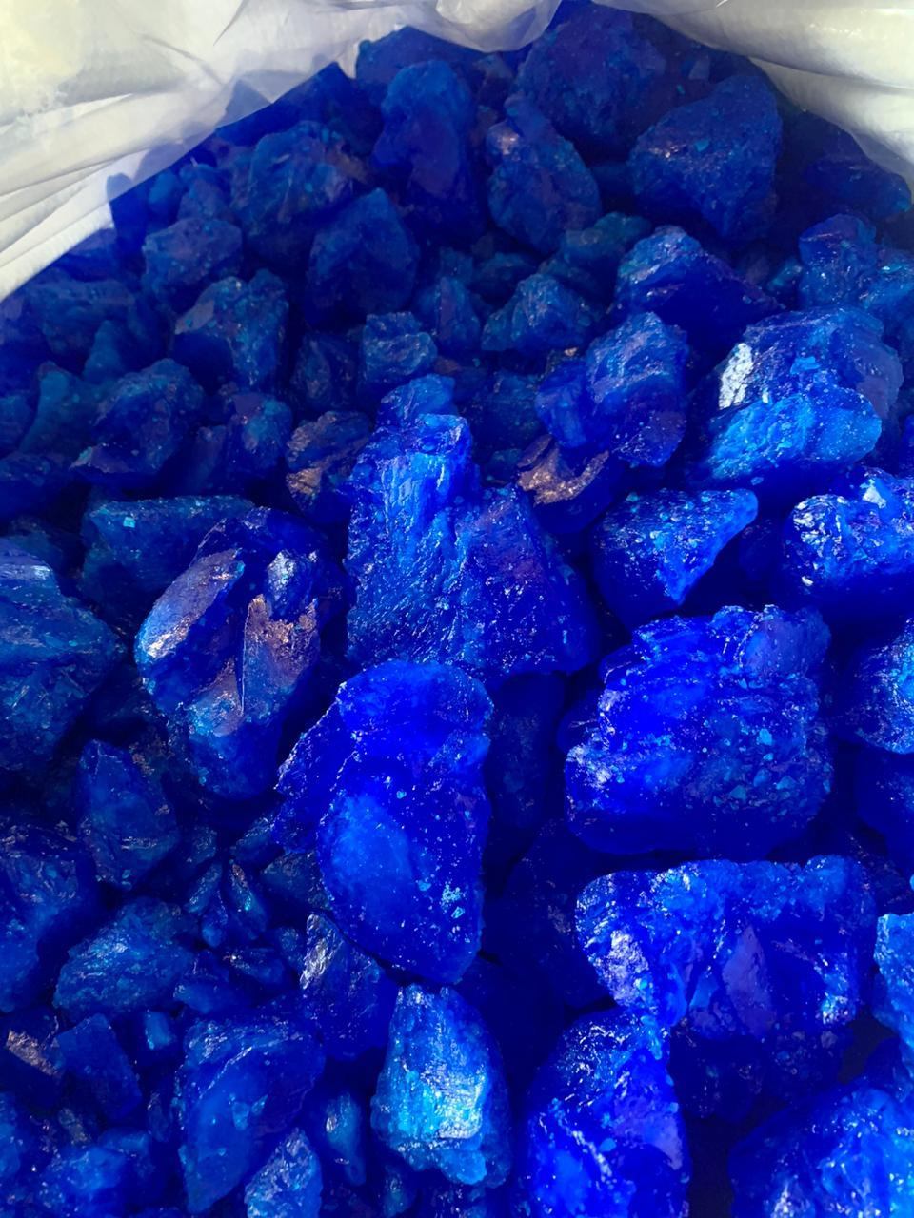

2016 – 2026
SOUTH-EAST ASIA COPPER SULPHATE MARKET
BY GRADE, By END USE,
BY TYPE, BY COUNTRY,
BY COMPANY, COMPETITION, FORECAST & OPPORTUNITIES
MARKET INTELLIGENCE . CONSULTING
www.ChemAnalyst.com

Slide 2
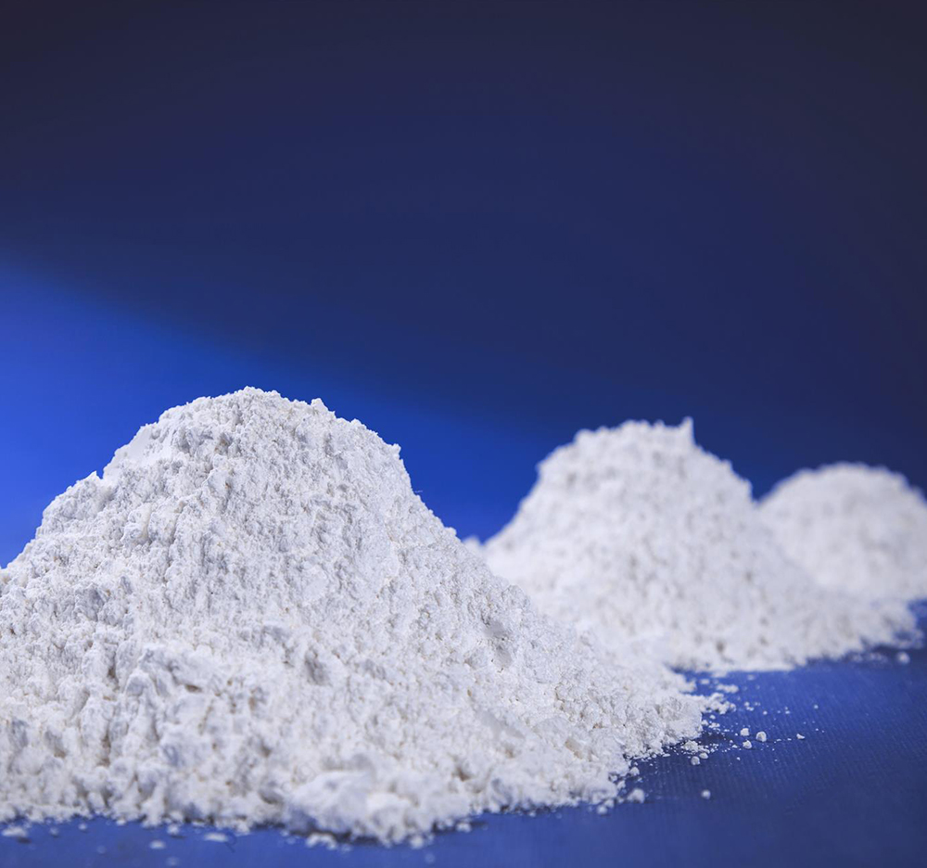
Scope of Report
Product of Interest (POI): Copper Sulphate
Copper sulphate or CuSO4 in an inorganic compound that combines copper and sulphate. In the liquid or powdered form, it is commonly called basic copper sulphate, tri – basic copper sulphate, or CP basic sulphate. In the solid form, crystal shaped stone is formed which is commonly known as pentahydrate or blue stone or blue vitriol for its blue color. In the solid form, it is mostly used as a raw material for producing other copper salts. It is a multipurpose chemical with large number of uses in industries as it has in agriculture. Copper Sulphate is having its end use in major industries like agriculture and pharmaceutical industry. Besides, it also finds extensive applications in several other fields like coatings, adhesives & sealant industries, construction industry, chemical industry, and others. Due to its ideal properties, it is often used in the pharmaceutical industry as an anti-malaria agent, antiseptic and germicide against fungus infections.
Market Segmentation
Type
END USE
Hydrous
Anhydrous
Agriculture
Animal Husbandry
Healthcare
Industrial
Chemicals
Leather and Textiles
Others
Review Period
2016 – 2019
Base Year
2020
Estimated Year
2021
Forecast Period
2022 – 2026
Year Range
GRADE
Industrial Grade
Reagent Grade
COUNTRY
Indonesia
Vietnam
Malaysia
Philippines
Thailand

Slide 3

Research Methodology

Slide 4

Research Methodology
Market Profiling
Formulating Questionnaire
Developing List of Respondents
Data Collection
Data Validation
Data Analysis
In-depth secondary research was conducted to determine top players in South-East Asia Copper Sulphate market, overall market size and segmental market size.
In order to conduct industry experts’ interviews, ChemAnalyst formulated a detailed discussion guide.
List of industry players and industry specialists was developed.
ChemAnalyst conducted interviews with industry experts and industry players for data collection and verification.
Data obtained as a result of primary and secondary research was validated through rigorous triangulation.
The data was scrutinized using MS-Excel, statistical tools and internal proprietary database to obtain qualitative and quantitative insights
Primary Research
Desk Research
Company Analysis
Identifying Key Opinion Leaders
Questionnaire Design
In-depth Interviews
Recent Developments
Market Changing Aspects/Dynamics
Government Policies
Final Conclusion
Market Participants
Key Strengths
Primary Research
Secondary Research
Paid Sources
LinkedIn
ChemAnalyst Internal Database
Company Websites
Company Annual Reports
White Paper Study
Financial Reports
Investor Presentations
Regulatory Body
Associations, etc.
Factiva
Hoovers
Data
Collection
Data Filter
& Analysis
Research &
Intelligence
Actionable
Insights
Business
Solution

Slide 5

Research Methodology
Respondents were asked about the current and future market growth rates, as well as market shares By Type, By End Use, By Grade, By Country and By Company. Removing the outlier responses, the geometric mean of growth estimates and provider wise revenue shares generated across various segments were considered, to arrive at the final revenue shares. Revenue shares generated across various segments were further triangulated from other stakeholders
Methodology Followed for Calculation of Market Shares:
Market shares by source, By Type, By End Use, By Grade, By Country and By Company were calculated based on the responses received through primary surveys with industry experts, in which the respondents were asked about the market shares of the leading Copper Sulphate supplier in South East Asia. The final shares were calculated by taking the geometric mean of the responses gathered from key opinion leaders after eliminating the outliers. Moreover, respondents were asked about the leading companies.
Methodology Followed for Forecasting:
ChemAnalyst performed periodical checks on data collected through the surveys with logical checks and analyzed the survey results in SPSS/Tableau Software.

Slide 6
Research Methodology
Data triangulation techniques were applied to fill the gaps and to present a more meaningful picture of the market. To forecast South-East Asia Copper Sulphate market, ChemAnalyst used various forecast techniques such as:
Moving Average
Time Series Analysis
Regression Analysis
Econometric and Judgmental Analysis
ChemAnalyst used its own forecast tool, which is based on the growth of various allied industries in respective regions. ChemAnalyst also used the impact analysis during short, medium- and long-term period to estimate and analyze market demand scenario.
Partial List of Secondary Sources | Metal Bulletin, CRU Group, UN Comtrade, World Bank, Industry Association, FaoStat
Partial List companies Interviewed | Chemtronic Technology (Thailand) Co Ltd, Pt. Lam Seng Hang Indonesia, Buildmore Enterprise Co., Ltd, Pt. Fajar Zippindo Pt, Allan Chemical Corp., ATOTECH, NOAH Technologies Corp., WEGO Chemical and Mineral Corp., Kirsch Pharma GmbH., JL Chemtonic Co., Ltd, Remix Resilient Mix Sdn. Bhd

Slide 7

South-East Asia Copper Sulphate Market Voice of Customer

Slide 8
Voice of Customer
Major Influencing Factor affecting Vendor Selection (N=50), 2020)
While conducting the consumer survey to derive the vendor selection, the consumers were asked to name factors which influences vendor selection. On the basis of their responses it has been found that availability of product is a major factor which influences the customer for selecting the vendor followed by brand with 90 percent ,price with 88 percent ,lead time with 85% and discount with 80% respectively.

Slide 9
Voice of Customer
Challenges Faced (Need-Gap Analysis), 2020
While conducting the consumer survey to derive the Challenges faced by customers, it has been observed that the product quality is the most important factor faced by customers with 88% of the total responses captured while other factors include after sales support with 85% ,supply chain management with 82% and credit period with 80% respectively

Slide 10
Voice of Customer
Satisfaction Level of Product Pricing (N=50), 2020
According to the survey, 88% of the respondents are partially satisfied with the product pricing while 78% of the respondents were highly satisfied and 42 % of the respondents were not satisfied.

Slide 11

Market Dynamics

Slide 12
Drivers
Growing Agriculture Sector
Agriculture accounts for around 10% of Southeast Asia’s GDP as of 2020. Government across Southeast Asian countries such as in Indonesia and others is focusing on increasing agriculture infrastructure (such as irrigation facilities, warehousing and cold storage) to obtain higher yields. This is expected to boost demand for copper sulphate being used as a fertilizers as it effectively helps in preventing fungus, algae and other unwanted microorganisms as well as helps in improving the quality of soil.
Positive Impact of GST on Fertilizers
Goods Service Tax has impacted the manufacturers of fertilizers in a positive manner. Now, they are entitled to pay 5% of tax whereas before GST, manufacturers were paying 5% of VAT along with 1% of excise duty. With this move, it is anticipated that in the near term, the indigenous fertilizers market would be benefitted. This would further boost the copper sulphate consumption across the Southeast Asian countries.
Southeast Asia Fertilizer Usage Kg per Hectare of Arable Land, By Country, 2017-2019
2016
2017
2018
2019
Source: Ministry of Agriculture & Farmers Welfare

Slide 13
Drivers
Limited Availability of Arable Land and High Demand for Fertilizers in Emerging Nations
Rising urbanization and industrialization are leading to the shrinkage of available arable land across the Southeast Asia. In order to increase yield and overall productivity, farmers use large quantities of fertilizers that not only prevent unwanted microorganisms, but also enhance soil quality. According to Food and Agriculture Organization (FAO), despite slow population and agriculture sector growth across Indonesia, Thailand and others, food production would continue to grow in the coming years across these countries. As arable farming land is continuously shrinking and it would be very difficult to supply food to the growing population, farmers across all geographies are using large quantities of copper sulphate as fertilizers in order to maximize yield per unit area.
Farmers in emerging countries across the region are often confronted with issues related to providing optimal nutrients to plants, in a cost-effective manner. Factors driving the copper sulphate market in the emerging markets include increasing demand for high quality fertilizers, increasing per capita income, rising farming standards, growing population, and extensive R&D for development of high-quality fertilizers. Major emerging countries in the copper sulphate fertilizers market include Indonesia, Thailand, Malaysia, among others. Emerging markets present tremendous untapped growth potential for new as well as existing market players.
Southeast Asia Share of Arable Land (% of total land area), 2018 & 2020

Slide 14
Challenges
Threat from Product Substitution/Technology Development
Zinc Sulphate is moving into some markets that is currently occupied by copper sulphate, especially in agricultural applications. Zinc Sulphate being comparatively less toxic than copper sulphate as copper becomes toxic to animals due to skin absorption. Along with and economical protection, cost effectiveness also plays an important role in choosing the right fertilizer.
Volatility in Raw Material Prices
The prices of copper sulphate experiencing fluctuations in recent years as it is highly dependent on the price trend of sulphuric acid. Sulphuric Acid is the major raw material used for the manufacturing copper sulphate along with copper oxide. This, fluctuation observed recently due to COVID-19 pandemic across Southeast Asia and worldwide impacted prices of copper sulphate significantly and fertilizer industry as well. Thus, shifts in the feedstock prices affects the gross margin for copper sulphate manufacturers, thereby limiting the growth of this industry in the region.
Southeast Asia Sulphuric Acid Pricing Analysis (USD/Tons), 2015-2021F
Source: The World Bank
Source: The World Bank

Slide 15
Challenges
Threat from Product Substitution/Technology Development
Zinc Sulphate is moving into some markets that is currently occupied by copper sulphate, especially in agricultural applications. Zinc Sulphate being comparatively less toxic than copper sulphate as copper becomes toxic to animals due to skin absorption. Along with and economical protection, cost effectiveness also plays an important role in choosing the right fertilizer. The demand of Zinc Sulphate is anticipated to grow further in end user industries like agricultural and animal husbandry due to its use in animal feeds, agricultural sprays and fertilizers further it can also be used to control the moss growth on roofs.

Slide 16
Market Trends & Developments

Slide 17
Trends & Developments
Escalating demand for Animal Feed
In order to address the ever-growing demand for food, animal husbandry have been observed significant growth in recent years. This is directly driving the copper sulphate across Southeast Asia which is widely used in animal feed as a basic nutritional supplement to treat copper deficiency in livestock. It is being added in animal’s diet in salt and other animal licks which mainly helps in fattening of pigs and broiler chickens by stimulation appetite. It is being consumed widely in many countries like Indonesia, Vietnam and others across the Southeast Asia as it also offers the lesser requirement of copper ions dosage by nearly 60% and hence significantly reduce cost as well as poisonous effects associated with copper ions. This will further drive the consumption of copper sulphate in coming years following surge in population and food demand.
Market Penetration
Companies are focusing on expanding their market reach and penetration across various countries across Southeast Asia due to strong competition from other players. Further, companies are offering lucrative incentives and schemes to dealers and distributors to boost their product sales. For instance, five percent cash discount is given to dealers on the marked dealer price coupled with several other offers derived for the dealers and stockiest varying from region to region. Companies are pushing their products by giving complete solution to end users, which include product cost, labor cost etc, which aids companies to develop their eco system of products as well as distribution. For example, Buildmore Enterprise Co. Ltd., one of the leading copper sulphate manufacturer also started the distribution of Cargill's raw materials for food and supplements in 2020.

Slide 18
Trends & Developments
Widespread Adoption of Organic Farming
Organic farming depends on sustainable techniques to enhance soil fertility and crop yield. Organic farming uses crop rotations, crop residues, animal manure, off-farm organic waste, mineral grade rock additives and biological system of nutrient mobilization and plant protection.
As of 2020, the area under organic agriculture across the Asia was about 6.2 million hectares which Philippines holding the largest share of nearly 72% followed by Vietnam and Thailand with anticipated higher growth across these countries in forthcoming years. Additionally, the Institute for Sustainable Agricultural Communities (ISAC) of Thailand encouraging organic farming in the country which is expected to reach 208,000 hectares by 2022.
Consequently, growing interest in organic farming, which utilizes organic nutrients to ensure high yields and maintain soil health also consume copper sulphate as an essential fungicide backed by its ability to kill fungi, algae and other pests via their membrane disruption. All these factors are expected to support growth of copper sulphate across different farming techniques and methods in the region.
Agricultural Land Under Organic Farming, By Country, Hectares
Source: Research Institute of Organic Agriculture (FiBL)

Slide 19

COMPETITIVE LANDSCAPE

Slide 20

Lam Seng Hang Indonesia. PT
Business Overview:
The company was established in 2000 and is a leading manufacturer of copper sulphate and is specialized in the supply of various industrial and specialty chemicals to different industries in Indonesia.
The company has its headquarter in Singapore.
The company is serving in chemicals for more than 50 years and have presence of around 15 years in Indonesia.
The company possesses strong research & development strength with technical research & development centre at municipal level.
The company provide its products in different segments i.e., for industry, for food, by functions, for pharmacy and essential oils.
The company expanded its business fields to food and pharmaceuticals industries in 2012.
The company also expanded its business scope to tyre division in 2014.
In the 1990s, the company also expanded its business in various other countries in Southeast Asia.
It provides different chemicals for different end user industries like paint, coating & ink, textile, adhesive, water treatment, oil & gas, metal treatment and feed.
Key Products:
COPPER SULPHATE PENTAHYDRATE
BENZOIC ACID
IPA ISOPROPYL ALCOHOL
FUMARIC ACID
PBTC
CHOLINE CHLORIDE 60% CORN COB
KEY MANAGEMENT PERSONNEL
Mr. Yue Huan Lee( Chairman & CEO)
COMPANY CONTACT ADDRESS
Cyber 2, Tower, Blok X5 No. 13, 12950 RT.7/RW.2 Kuningan Timur Kota Jakarta Selatan DKI Jakarta ID 12950, Jl. H. R. Rasuna Said, RT.1/RW.2, Kuningan, Kuningan Tim., Kecamatan Setiabudi, Kota Jakarta Selatan, Daerah Khusus Ibukota Jakarta 12950, Indonesia
Contact No: +62 21 29021438
Source: http://lsh-indonesia.com/

Slide 21
Chemtronic Technology (Thailand) Co.,Ltd.
Business Overview:
The company was established in 2006 at at Rojana Industrial Park, located in Ayutthaya Province, Thailand.
It is one of the leading manufacturer in the copper sulphate.
The company focuses on product development, production and service, quality, safety and customer satisfaction.
The company possesses strong research & development strength with technical research & development centre at municipal level.
The company’s mission is to provide the product copper sulphate with international quality standards and competitive prices.
The company produces copper sulphate pentahydrate which has its application in fertilizer in plantation, animal feed additive, wood fungicides, soil improvement, fishery and shrimp goods.
It is certified with ISO 9001 : 2015, CODEX : GMP, and FAMI - QS.
KCE Electronics Public Company Limited acquired Chemtronic Technology Co. Ltd. on Oct 2,2012 which holds 94.75% of shares.
It provides copper sulphate with certain specifications like purity with greater than 98%, and lead with maximum 50 ppm.
Key Products:
COPPER SULPHATE PENTAHYDRATE
KEY MANAGEMENT PERSONNEL
Mr. Anastasios Papadopoulos(Chairman & CEO)
COMPANY CONTACT ADDRESS
28 1 Khan Ham, Uthai District, Phra Nakhon Si Ayutthaya 13210, Thailand
Contact No: +66 35 719 674
Source: http://www.chemtronic-thai.com/

Slide 22

Buildmore Enterprise Co., Ltd
Business Overview:
The company was established in August 1984.
The company has its headquarter in Taipei.
The company is specialized in tariff barriers and in import/export.
The company is currently in partnership with chemical and machine manufacturers in middle Taiwan.
The company has two divisions – Chemical and Food.
In 2002, the company established the food department with GELITA in extending the use of gelatin products into foods, drugs and supplements .
The company also began the distribution of Cargill’s raw materials for food and supplements which provides quality raw materials to foreign suppliers.
The company produces various chemicals like Aluminium Sulphate, Antimony Trioxide, Cobalt Oxide, Copper Sulphate Pentahydrate, Zinc Sulphate Heptahydrate etc.
It provides different chemicals for different end user industries like agriculture, livestock and poultry feed, water treatment, sewer treatment, chemicals, pigments, metals, wood preservative, mining, fertilizer etc.
The food division has different product lines i.e., food ingredient, food additive, functional raw materials etc.
Key Products:
Copper Sulphate Pentahydrate
Aluminium Sulphate
Calcium Phosphate
Ferric Chloride, Solution
Zinc Sulphate Monohydrate
Gelatine
Konjac Gum
Isomalt
Collagen Hydrolysate
KEY MANAGEMENT PERSONNEL
Mr. Yue Huan Lee( Chairman & CEO)
COMPANY CONTACT ADDRESS
7F-2, No. 57, Fu-Hsing N. Rd., Taipei, Taiwan, R.O.C.
Contact No: +886 -2- 2752－3137
Source: http://www.bm-group.tw/

Slide 23

Fajar Zippindo. PT
Business Overview:
Fajar Zippindo. PT was established in 1995.
The company has its headquarter in Tangerang, Indonesia.
It is specialized in manufacturer of Copper Sulphate.
The company is currently having the annual production capacity of 1800 tons per year.
Fajar Zippindo. PT has around 40 workers in the factory.
It provides copper sulphate with purity of 97 +/- 0.5%.
It produces copper sulphate in two major grades – Industrial and feed.
The company provides the product in two forms- powder and crystalline.
It produces copper sulphate for different applications like animal feed, fungicide, algicide, electroplating herbicide, as fertilizer and in industrial manufacturing.
The company provides copper sulphate with specific specifications like Fe – 50 ppm, Pb – 30 ppm, As – 5 ppm, Cd – 5 ppm, Hg – 5 ppm, Cr – 5 ppm and Cu – 24, 5% min.
The packing details of the product includes 25 Kg/Bag or 1 MT/ Jumbo Bag.
The company is committed to provide its customers with quality product and good partnership.
Key Products:
Copper Sulphate Pentahydrate
KEY MANAGEMENT PERSONNEL
Ms. Ruri Ruri (Key Account Personnel)
COMPANY CONTACT ADDRESS
Jl. Daan Mogot Km 19/22, Jurumudi Baru Benda, Batu Ceper, Jakarta, 15122, RT.7/RW.3, Kalideres, West Jakarta City, Jakarta 11840, Indonesia
Contact No: +62 21 5407234
Source: https://www.zippindo88.com/

Slide 24

JL Chemtonic Co., Ltd.
Business Overview:
JL Chemtonic Co., Ltd. was established in 2005.
The company has its headquarter in Thailand .
The company is the largest manufacturer of Copper Sulphate Pentahydrate, Ferric Chloride, Ferrous Chloride, Poly Ammonium Chloride Liquid in Thailand.
It is also the major supplier of Chlorine, Sulfuric Acid (98%, 70%, 50%, 35%), Hydrochloric Acid (18%, 35%), Caustic Soda Solution (32% and 50%) and other chemicals.
The products produced by the company is used in many different end user industries which includes dairy farming, animal feed, water treatment as an aquatic algaecide, food and pharmaceutical processing and pool chemicals.
The products produced by the company are used in various application in different industries like plating and metal industry, auto parts industry, electronic industry, food and beverage industry, paper industry and many more.
The supply ability of copper sulphate by the company is 1500 Tons/per month.
It provides the product in 25 kg, 50 kg, or 1 MT net in PP woven bag with PE bag inner.
The company is committed to provide its customers with quality product and good partnership.
Key Products:
Copper Sulphate Pentahydrate
Ferric Chloride
Poly Aluminium Chloride
Ferrous Sulphate
Ferrous Chloride
KEY MANAGEMENT PERSONNEL
COMPANY CONTACT ADDRESS
9/9 Moo 1 Chaimongkhon Dist Rd. Tumbol Chaimongkhon, Amphoe Mueang Samut Sakhon, Samut Sakhon 74000, Thailand
Contact No: 0-3488-1246-7
Source: http://www.jlchemtonic.com/

Slide 25

Resilient Mix Sdn. Bhd. (REMIX)
Business Overview:
Resilient Mix Sdn. Bhd. (REMIX) was established in 2005.
The company is in Juru Industrial Park, Penang, West Malaysia.
It has its full facility to produce copper sulphate from pure copper metal.
The company usually produces two grades of Copper sulphate- feed and industrial grade.
According to different grades produced, the product is used in various applications such as mineral additive, wood preservative, agriculture, electroplating and as a catalyst in chemical industry.
The company is capable to produce 5000 tons per annum of copper sulphate.
The copper sulphate produced by the company has excellent quality which provides free flowing crystal powder extended shelf life and full dryness which allows its usage as a dietary supplement in animal feed and poultry farm industries.
It provides the product in 25 kg UN approved bags on shrink wrapped pallets of 1 ton.
It provides copper sulphate with 98% purity with iron content 100 ppm, lead 20 ppm, and Nickel 20 ppm.
The company possess full facility to produce, reprocess, and distribute all grades of copper sulphate.
Key Products:
Copper Sulphate Pentahydrate
KEY MANAGEMENT PERSONNEL
COMPANY CONTACT ADDRESS
81 & 83,Jalan Industri Beringin,
Taman Perindustrian Beringin, 14000 Juru,
S.P.T. , Penang, Malaysia
Contact No: +604 5024 282
Source: https://www.remixsb.com

Slide 26

Strategic Recommendations

Slide 27
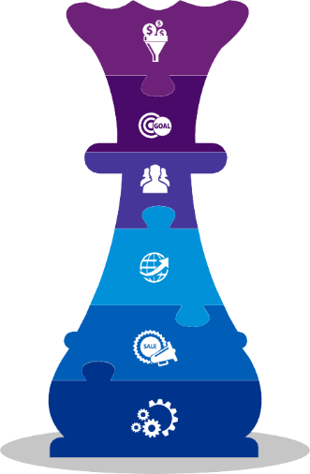
Emphasize on Feed Grade
The demand for Feed Grade copper sulphate, consumed in high volume in animal husbandry anticipated to expand at a highest CAGR of 6.08% during the forecast period 2026. Whereas the major demand comes from agricultural sector across Southeast Asia which is estimated to hold nearly 42% share in value terms, as of 2020. This dominance is attributed to the high consumption of copper sulphate being employed in the fungicide, herbicides, fertilizers, etc. to protect crops against molds, algae, bacteria etc. Additionally, it providing essential nutrient to plants.
Ample opportunities of copper sulphate in animal husbandry owing to its antimicrobial properties and its ability to help in promoting growth and treat copper deficiencies in animals. As region is experiencing huge demand for meat consumption mainly poultry and pork which is further anticipated to manifold increase in coming years as well.
Thus, sulphur fertilizer companies are recommended to focus on production of feed grade copper sulphate during forthcoming years in order to maintain strong presence in the market.

Slide 28
Target Country – Indonesia
Indonesia dominated Southeast Asian copper sulphate market with share of 41.72%, in volume terms, in 2020. High availability of arable land in the country has made it one of the leading crops producers and food exporters in the region, thereby generating huge demand for fertilizers, fungicides etc. in the country to ensure maximum yield. Despite having a smaller workforce, agricultural sector in the Indonesia holds significant share across the region.
Currently, Indonesia is importing large volume of copper sulphate following growing demand and have easy access to the exporting countries like China and Japan. Also, shifting preference for customized diets and eating patterns has generated demand for protein meals in the country. The significant growth in the per capita meat consumption across Indonesia has witnessed in past few years following increase in income across the country. This generate the demand for copper sulphate used widely across animal feed to fortify food as well as prevent mold growth. These factors have resulted in increased in the demand for copper sulphate in the country backed by surging animal husbandry across the country. Hence, sulphur fertilizer companies are recommended to increase their focus on Indonesia in order to tap the emerging opportunities in the market.

